Slide 1
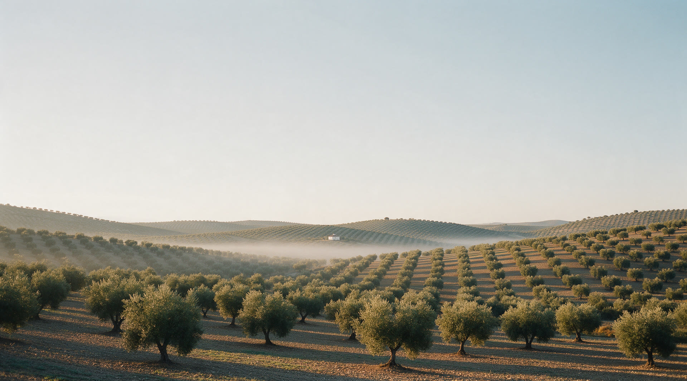
Oro Verde
Early-harvest extra virgin olive oil · Distributor pack

Slide 2
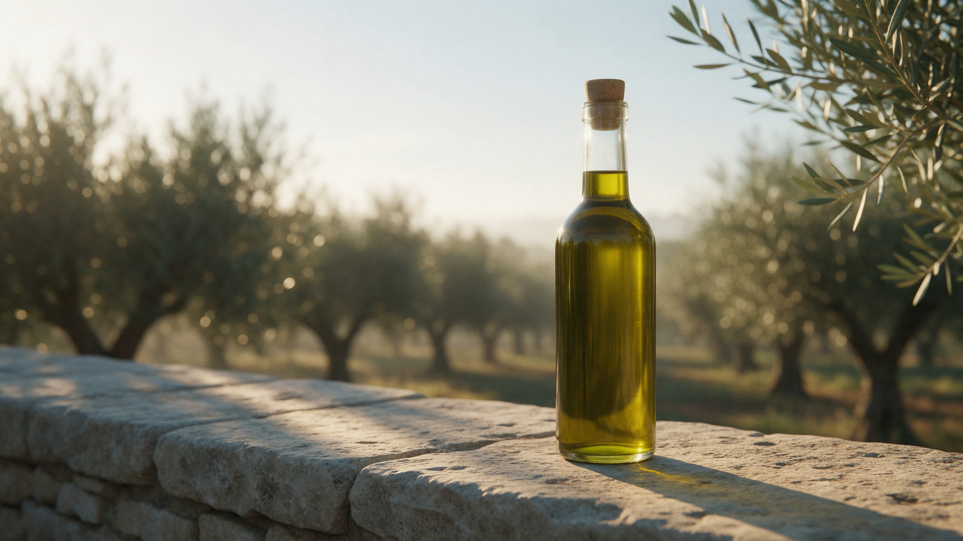
The oil
Picual olives
From family groves in Jaén, Andalusia.
Pressed the same day
Early harvest, cold extraction, small batches.
Green and peppery
Fresh grass, tomato leaf, a clean bitter finish.
Oro Verde · distributor pack · sample deck from the demo
2

Slide 3
Why it sells
Premium shelf, fair price
A story people repeat
Gift ready
Sits next to the leading gourmet brands without the gourmet mark-up.
One valley, one family, one harvest window.
Clear glass, natural cork, a label that photographs well.
Oro Verde · distributor pack · sample deck from the demo
3

Slide 4
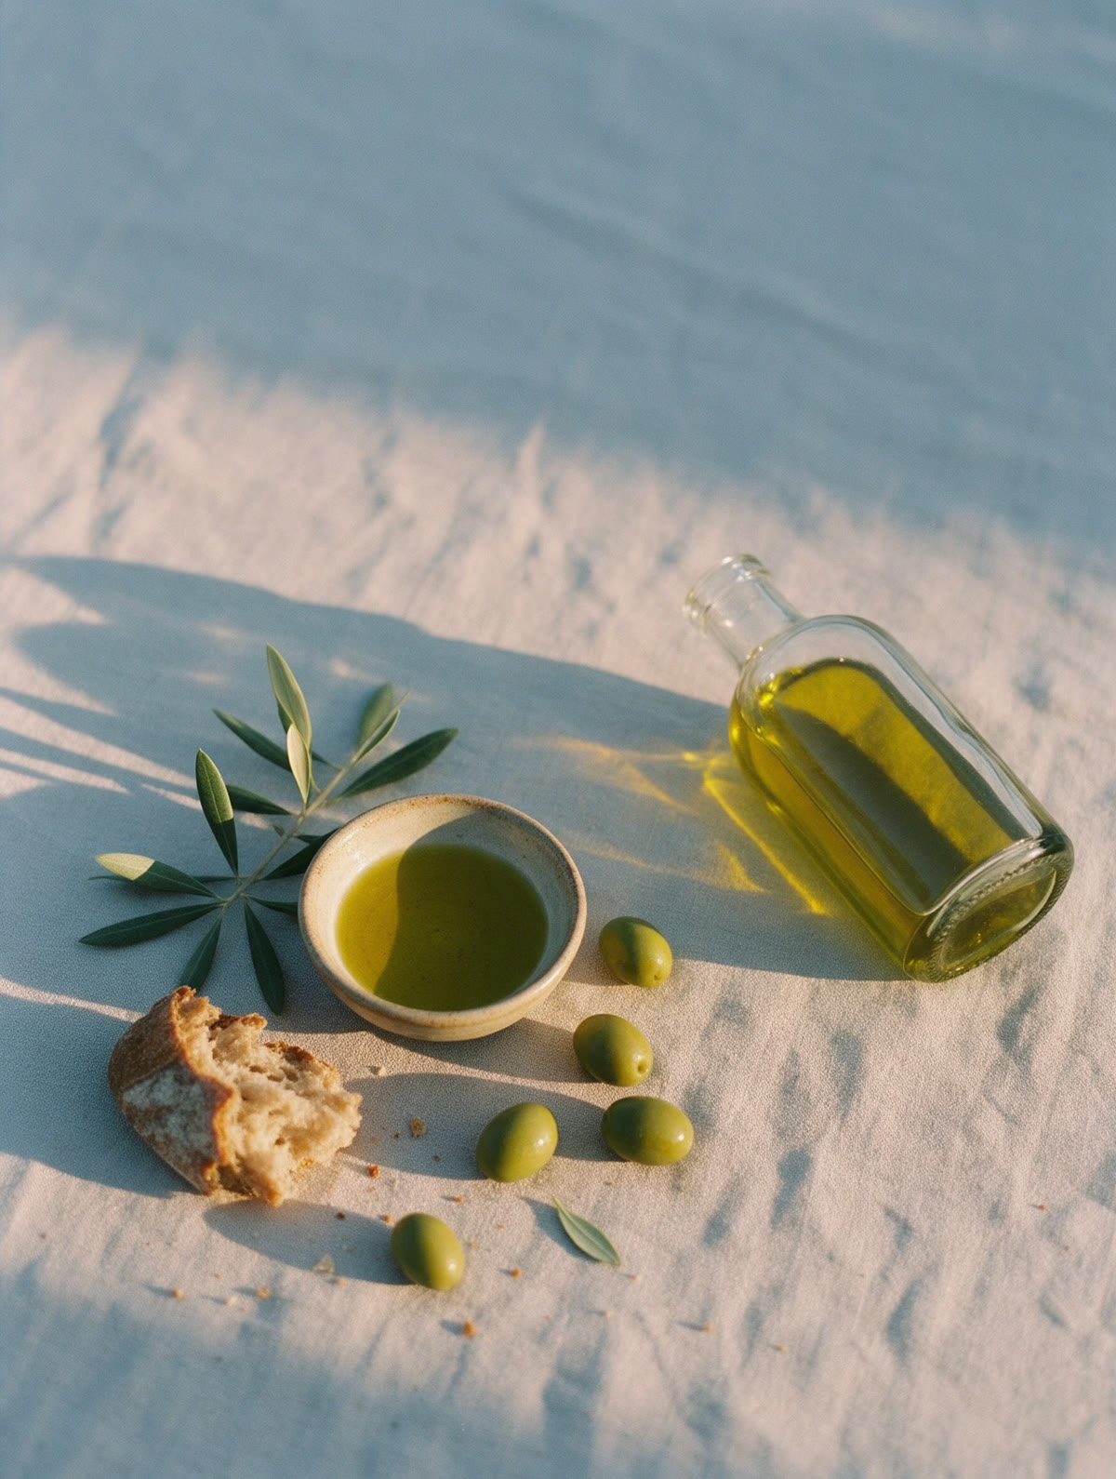
The range
250 ml gift bottle
For delis, gift boxes and tourist shops.
500 ml kitchen bottle
The everyday premium bottle for supermarkets.
3 litre tin
For restaurants and hotel kitchens.
Oro Verde · distributor pack · sample deck from the demo
4

Slide 5
Launch plan
1 Tastings
2 Social
3 Restaurants
In-store tastings with partner shops in the first month.
Product film and photos on Instagram, with the jingle.
Free 3 litre tins for chefs who list the oil by name.
Oro Verde · distributor pack · sample deck from the demo
5

Slide 6
Let's talk
Order a sample case and price list.
sales@oroverde.example
Sample deck generated in the demo. Oro Verde is a fictional brand.

